Slide 1
UNEMPLOYMENT SOCIAL COHESION AND GOVERNANCE IN (SOUTH) AFRICA
27TH NOVEMBER 2014
EPWP SUMMIT
PRETORIA, SOUTH AFRICA
KOFFI M. KOUAKOU
WITS SCHOOL OF GOVERNANCE

Slide 2
-1-
Context and Meanings
-2-
Unemployment
-3-
Social Cohesion
-4-
Governance
-5-
THE IMPERATIVE NEXUS
-6-
Conclusion

Slide 3
"To govern - means to foresee.
Without foreseeing one cannot govern ."
Anonymous proverb

Slide 4
CONTEXT AND MEANINGS

Slide 5
THE SIX HORSEMEN OR THE DOUBLE TRIPLE CHALLENGES

Slide 7
Poverty Inequality
Unemployment
Corruption
Crime Intolerances of All Sorts

Slide 8
UNEMPLOYMENT definition. brief history. some figures

Slide 10
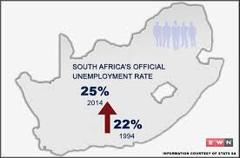

Slide 11
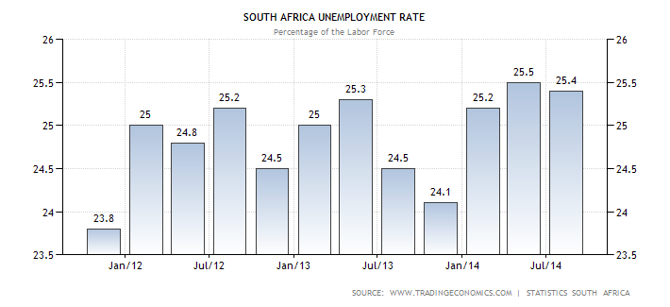

Slide 12
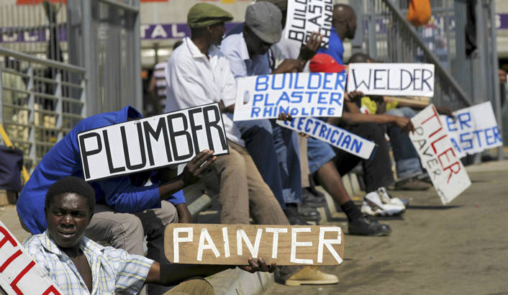

Slide 13
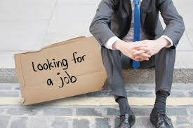

Slide 14
SOCIAL COHESION definition. brief history. some figures

Slide 15
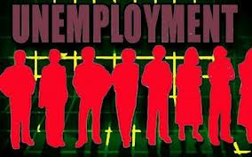

Slide 16
GOVERNANCE definition. brief history. some figures

Slide 17
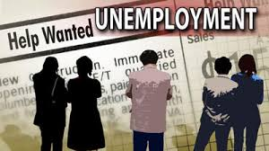

Slide 18
Government and Governance
Unemployment

Slide 19
THE IMPERATIVE NEXUS

Slide 20
THE JUSTIFICATION FOR
THE IMPERATIVE NEXUS

Slide 21
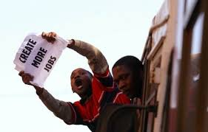

Slide 22
Governance
Employment
Unemployment
Social Cohesion
Development

Slide 23
CONCLUSION

Slide 24
SO WHAT?

Slide 25
THE IMPERATIVE NEXUS

Slide 26
"To govern - means to foresee.
Without foreseeing one cannot govern ."
Anonymous proverb

Slide 27
THE IMPERATIVE NEXUS governance. EMPLOYMENT. social cohesion.

Slide 28
"To govern - means to lead.
To lead is govern well."
Anonymous proverb

Slide 30
THANKS
SUNDAY 27TH NOVEMBER 2014
KOFFI KOUAKOU
WITS SCHOOL OF GOVERNANCE
koffi.kouakou@wits.ac.za

